Slide 1
Angular signals
Notes:
In this presentation I will talk about angular signals. I will start from the most basic things, and go through more advanced details and nuances

Slide 2
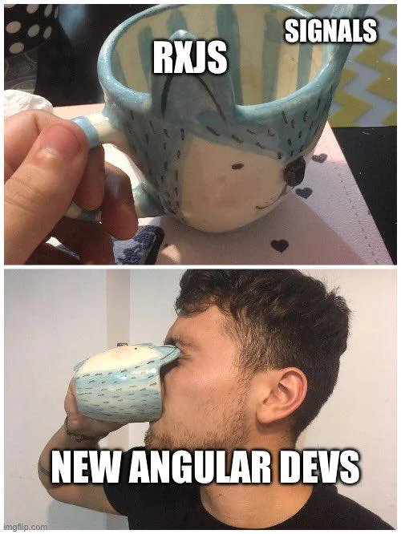
Signals
Signals were released in angular v16
Initially caused a lot of confusion among developers
But now they see more and more use in angular applications
Notes:
Signals were introduced to angular in version 16. Since then there's quite a lot of confustion among developers. Especially around the release there has been many questions on stackoverflow about this topic, whether to use signals, how to use them, how are they different from rxjs observables. But now that over a year since signals release passed, they see more and more usage in angular applications. It's good to learn them. So what exactly are signals?
Released in 16
Confusion among developers, many questions
Where and where can be used

Slide 3
What are signals?
Signal is a wrapper around value
It can contain any value, from primitives to complex data structures
It is integrated with angular's change detection
It notifies interested consumers when the value changes
Notes:
Signal is a wrapper around value
It can contain value of any type
And, what's the most important, signal notifies interested consumers when the value chanes
We will get into details of that third point later.
Integration with change detection guarantees better efficiency
first let's see how do signals look like

Slide 4
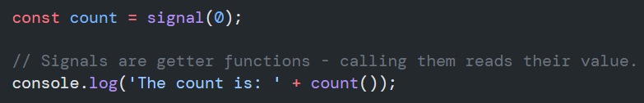


Signals syntax
Declaration of a signal and reading its value. Signal() function returns object of type WritableSignal<T>, where T is type of value it wraps
.set() method can be used to manually set signal's value
.update() method can be used to update signal's value basing on the current one
Notes:
Signal object overview
To create, or to declare a signal, angular provided a function which returns new signal object. It takes initial value as a parameter.
Then, to retrieve value from a signal, we simply use it like a function.
Signals also provide methods to set the value manually. One method is set(), which simply sets provided value. And another is update(), which can set new value basing on a current one.
Now we know what signals are, and we know their interface. But so far there hasn't been anything too useful, we just have simple wrapper around value, with which we can't do much more than with bare value.
So here's when we get to more interesting features.

Slide 5

Computed signals
Computed signals base on other signals:
Computed signal is lazy – it's only calculated when it's read
Computed signal's value is memoized – it's only recalculated if signal it's dependent on changes
Notes:
Signals inform consumers about changes
Computed are signals, which compute their value based on other signals. We can't set their value manually, their behaviour is set once during initialization with computed() function.
So why is it useful? Can be used to achieve declarative programming
You define behaviour during declaration
No need to care about it later

Slide 6
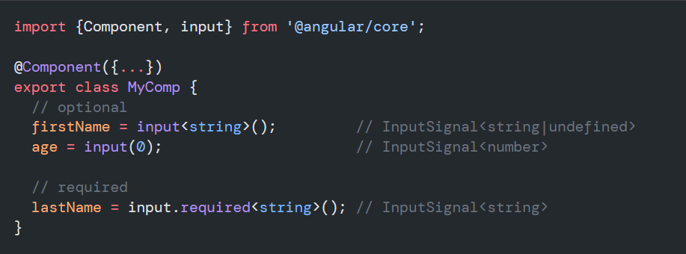
Signal inputs
New inputs are of signal type
More type safe than standard input
Notes:
Slide image:
1.Angular introduced signal inputs.
2.New syntax with input function
3.You can explicitly specify type of input, or mark input as required, to cause compilation error when it's not provided.
Description 1. inputs of type signal – all signal features
2. required inpupts don't require initial value to trick typescript

Slide 7
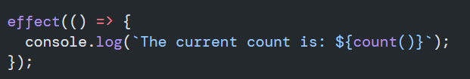
Effects
Like computed, they're based on other signals
Invoke an action when some of their dependencies change
Can be run only in injection context
Execute asynchronously during change detection proces
Notes:
Don't like effects – because of last point, as it has some implications

Slide 8
When not to use effects
Avoid using effects for propagation of state changes. This can result in:
ExpressionChangedAfterItHasBeenChecked errors
Infinite circular updates
Unnecessary change detection cycles
By default it's impossible to set signal value inside of effect – it can be disabled with "allowSignalWrites" flag.
Notes:
Don't propagate state – this is what computed is for
Ngrx store – doesn't work – you can use allowSignalWrites – but try not to rely on it if it is used in current view

Slide 9
When to use effects
Logging data being displayed and when it changes, either for analytics or as a debugging tool
Keeping data in sync with window.localStorage
Adding custom DOM behavior that can't be expressed with template syntax.
Performing custom rendering to a <canvas>, charting library, or other third party UI library.
Notes:
Those points are straight from angular documentation – it's whata angular team advises as to do with effects

Slide 10
Other signal functionalities
Model signals
Signal queries:
viewChild
viewChildren
contentChild
contentChildren

Slide 11
Signals vs rxjs
Are signals replacement for rxjs?
No, but they can replace SOME of rxjs functionalities
Signals are for synchronous operations – they always have a value
Why use signals when we have rxjs?
Signals are simpler and easier to work with
Signals are better integrated in angular (e.g. signal inputs)
We don't need to worry about signals lifecycle – no unsubscribing
Notes:
Finally comparison with rxjs
1.
Signals are not replacement for rxjs. But! They can replace some of rxjs functionalities.
Signals are used in synchronous context – not meant to work with for example http calls
2.
Signals only have a chunk of rxjs capabilities – but they're much simpler
Signals are integrated into some core angular features like signal inputs
While obesrables are widely used, they are not as integrated.
No risk of memory leak

Slide 12

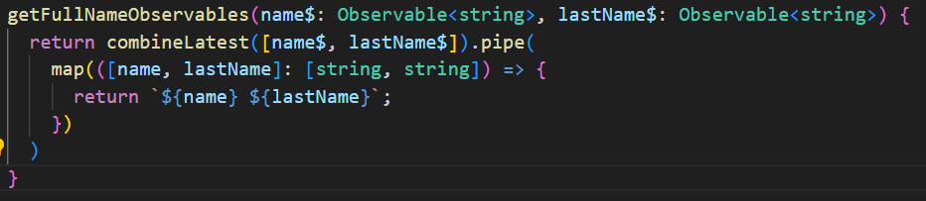
Signals vs rxjs
Signals:
Rxjs:

Slide 13
Rxjs introp
There are two functions created to join rxjs and signals:
toSignal()
toObservable()
Notes:
Enable devs to combine
Still in developer preveiw

Slide 14
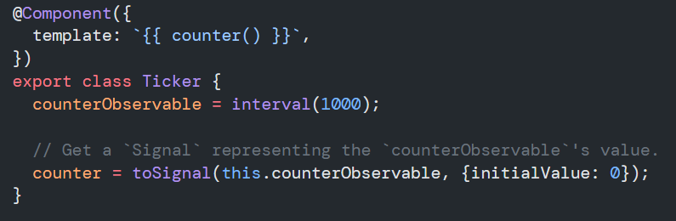
toSignal()
toSignal() functions creates a signal which tracks value of an observable
It subscribes to observable to track its value
It needs to run in injection context
Notes:
toSignal() functions creates a signal which tracks value of an observable. Initial value should be passed in case observable doesn't emit immediately
Show example
ToSignal() requires injection context – we can either call it in constructor, or pass injector as a parameter.
ToSignal() immediately subscribes to the observable. It automatically unsubscribes when component or service is destroyed.
Because of that you should avoid calling it repeatedly – isntead reuse the returned signal

Slide 15
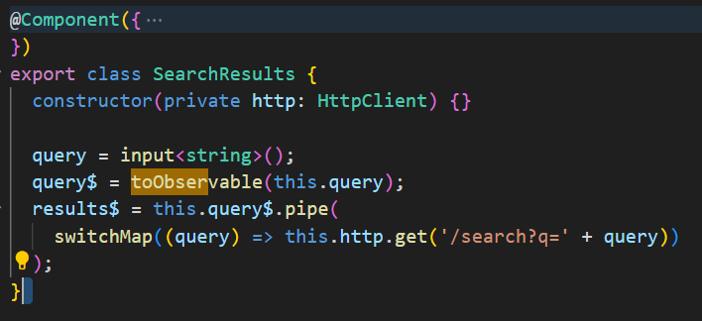
toObservable()
toObservable() functions creates an observable which tracks value of a signal
It uses signal's effect to track its value
It needs to run in injection context
Notes:
toObservable() functions creates an observable which tracks value of a signal
Show example
Similar as ToSignal(), it needs to run in injection context.
ToObservable() method uses signal's effect to track its value
While first value might be emitted synchronously if available, subsequent values will be asynchronous

Slide 16
Summary
Signals are nice tool for reactive programming
They don't require global architecture redesign - can be used in single components
They can be used along with Rxjs observables
They can make angular application more efficient

Slide 17
Thanks for your attention!
Git hub repo with examples and presentation: https://github.com/Mgrabowski147/AngularSignalsPresentation
Angular signals documentation: https://angular.dev/guide/signals

